Slide 1
Presentation template for your programme
Instructions for using this presentation
Please personalize this presentation
This is intended as a general outline. Please add pictures and text about yourself, your research, and the programme that you represent.
Think of stories to tell related to the specific topics. In what way do you find Sweden innovative? How do you experience ”closeness” living in Dalarna?
How is your interaction with students?

Slide 2
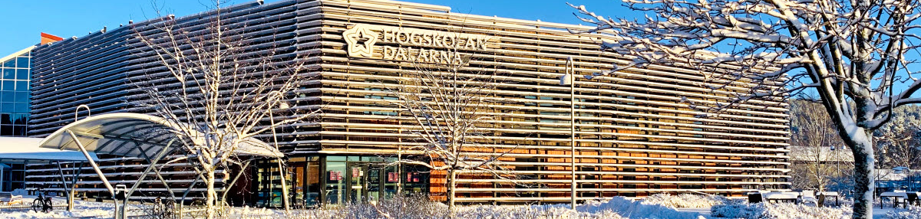
About Dalarna University
Photographer, Martin Ström
Notes:
Choose this if a winter picture is more appropriate

Slide 3
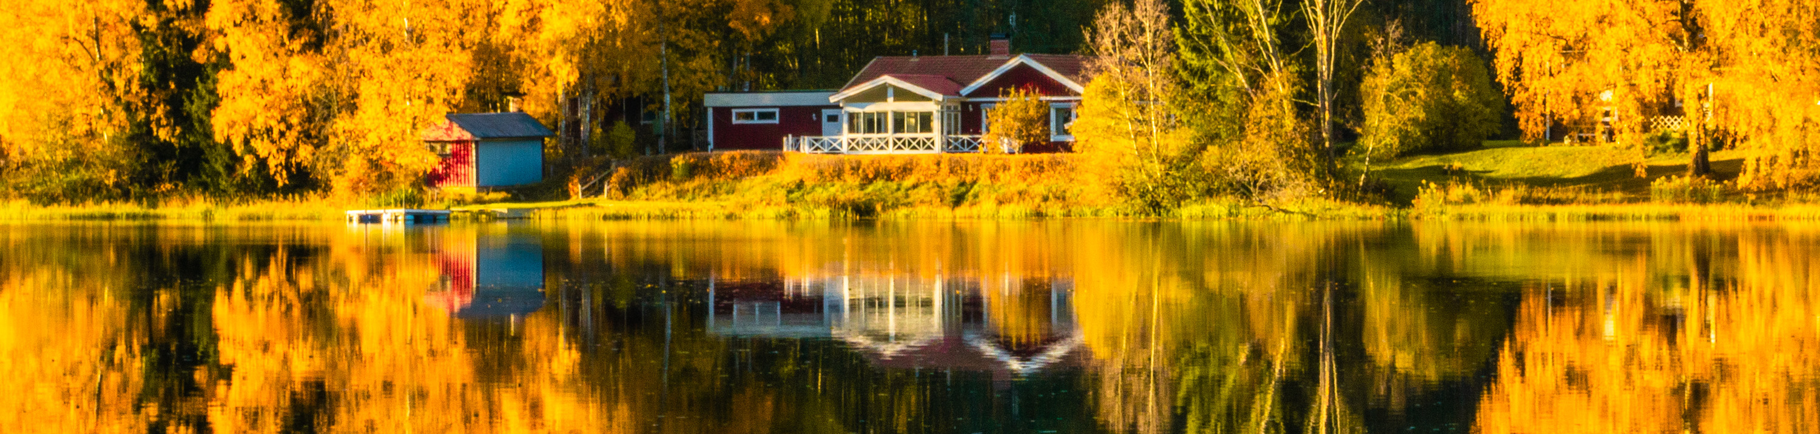
About Dalarna University
Photographer, Fabian Gaukler
Notes:
Choose this if a summer picture is more appropriate

Slide 4
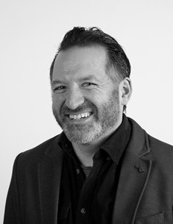
Your name:
About me
From: (talk about how you came to Dalarna)
Title/roll (what do you do? What do you teach?)
Fun fact about you/something that most people don’t know about you: Example
Speak 5 languages, lived in over 4 countries, visited more than 30 countries, best thing you can cook
(PLEASE ADD YOUR PICTURE)
Notes:
Present yourself

Slide 5
Agenda for this presentation
Instructions for using this presentation
Please personalize this presentation
This is intended as a general outline. Please add pictures and text about yourself, your research, and the programme that you represent.
Think of stories to tell related to the specific topics. In what way do you find Sweden innovative? How do you experience ”closeness” living in Dalarna?
How is your interaction with students?

Slide 6

Sweden is smart and innovative
About Sweden
Sweden regularly tops global indexes as one of the world’s most innovative countries
Home of the Nobel Prize
Have you heard of our innovative global brands?:
  H & M
  ABB
  Volvo
  Spotify
  IKEA
Photo: studyinsweden.se​
Notes:
Do we add ”what is important?” Learning process is what is important”
Sweden encourages life long learning. Perhaps add to the DU information.

Slide 7
Sweden is smart and innovative
About Sweden
Top ranked university system (Universitas 21)
  All universities share an excellent quality of teaching and research
  No difference in quality between university college and university
  Rankings not important to Swedes (equal society)
Photo: studyinsweden.se​

Slide 8
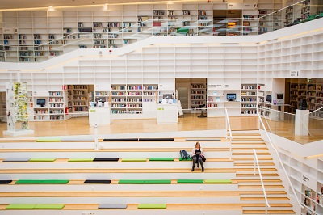
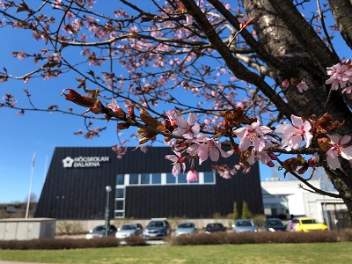
Dalarna’s location
About Dalarna
Campus Falun
Dalarna is a province located about 200 kilometers from Stockholm, less than 2.5 hours by train.
Falun and Borlänge are Dalarna’s biggest towns; combined population 100 000 people.
Two campuses in Falun and Borlänge (around 4000 students study on campus).
Campus Borlänge
Photographer: Yasir Imam, Xi Su

Slide 9
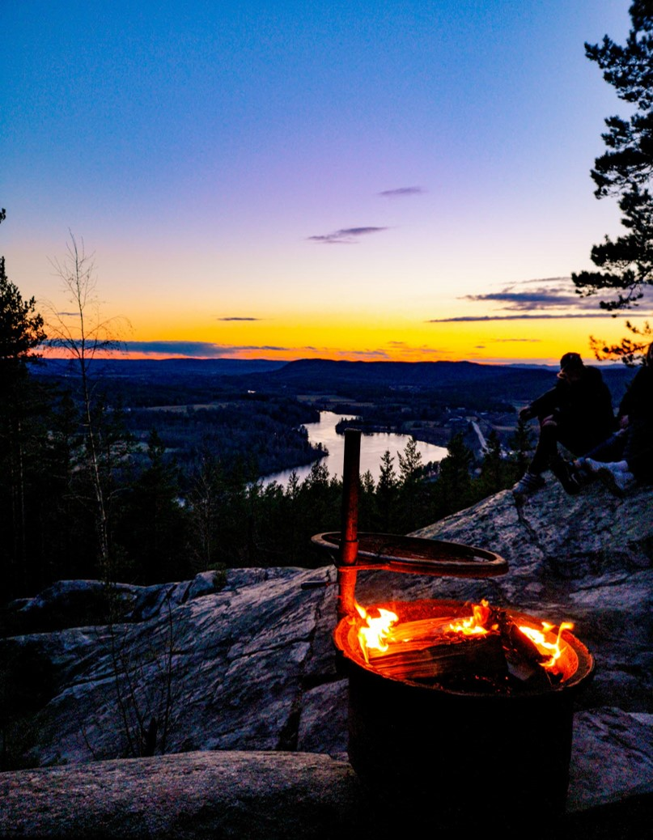
Dalarna is the Heart of Sweden
About Dalarna
“Traveling in Dalarna is like experiencing Sweden in a miniature.”
Major cultural celebrations and beautiful nature are always close by and encourage an active lifestyle.
Photographer: Yasir Imam (former student)

Slide 10
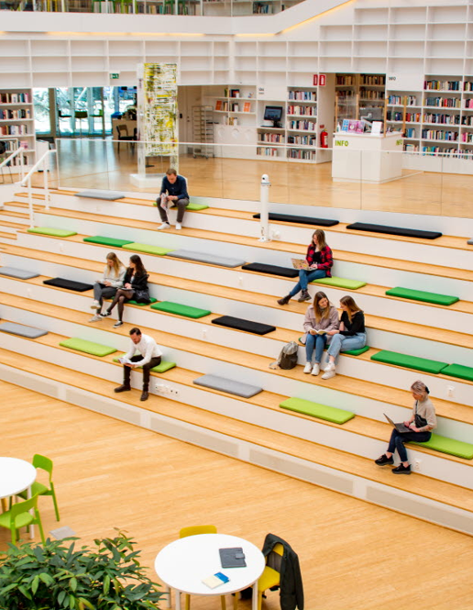
Dalarna University is modern
About Dalarna University
Founded in 1977 and a pioneer in incorporating technology in education
10 000 students study online
Photographer: Yasir Imam (former student)

Slide 11
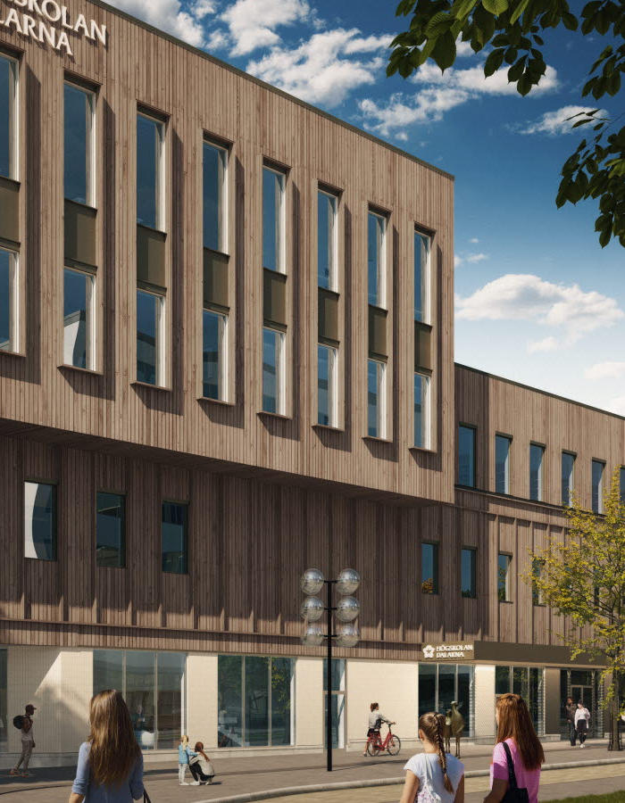
Dalarna University is modern
About Dalarna University
Founded in 1977 and a pioneer in incorporating technology in education
10 000 students study online
We are building Sweden’s most modern and sustainable campus
Photo credit: Archus
Notes:
Most modern campus: Flexible classroom and usage situations built around active learning pedagogy.
Most sustainable – repurposing an existing building. Repurposing furniture. Built with energy efficiency as a keyword and will be rated by an international building standard for energy efficient buildings (BREEM)

Slide 12
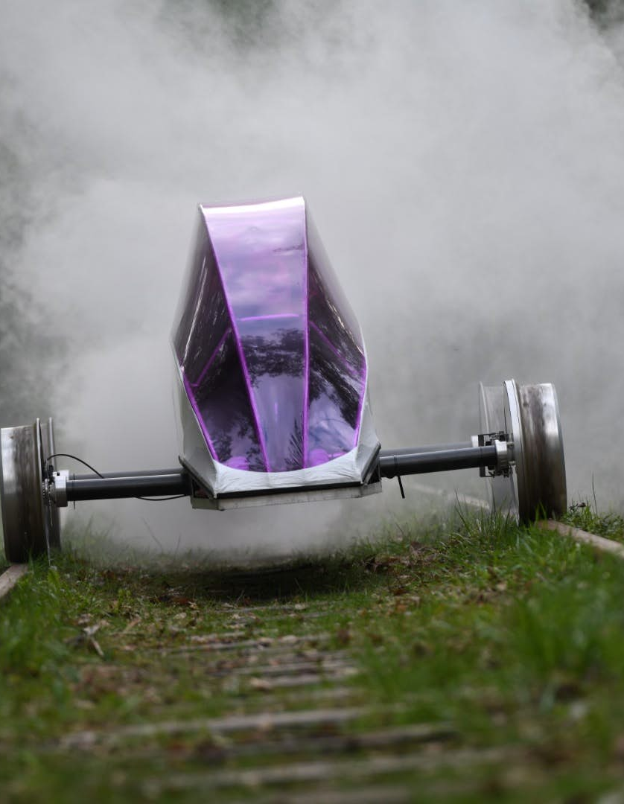
Dalarna University is modern
About Dalarna University
Founded in 1977 and a pioneer in incorporating technology in education
10 000 students study online
We are building Sweden’s most modern and sustainable campus
Our students built the most energy efficient vehicle in the world
Photo credit: Delsbo Electric
Notes:
Guiness world record for most energy efficient vehicle in the world.
Powered by batteries, the amount of energy used is much less than other electric vehicles. If you take the amount of energy contained in 1 liter of petrol, you could go from Sweden to Brazil in Eximus IV (the world record holder).
Sidenote – The original world record was held by Eximus 1, broken by Eximus 2, broken again by Eximus 3 and one more time by Eximus 4.

Slide 13
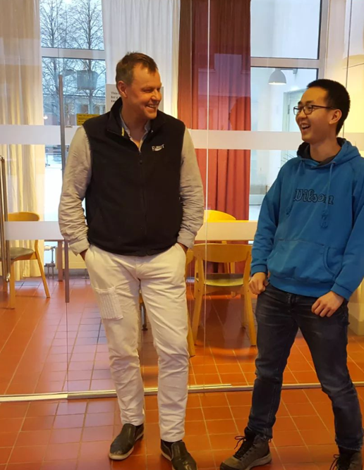
Dalarna University is close
The student experience
Create close relationships with teachers who will be your mentors (TALK FROM YOUR OWN EXPERIENCES)
Photographer: Yasir Iman (former student)

Slide 14
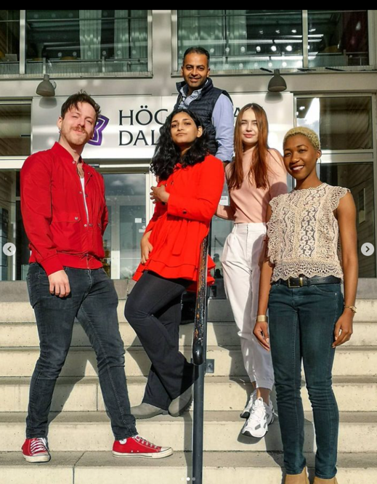
Dalarna University is close
The student experience
Create close relationships with teachers who will be your mentors.
Make close friendships with peers from around the world. Over 500 international students from 70 countries study at DU.
Photographer: Arman Golshan (former student)

Slide 15
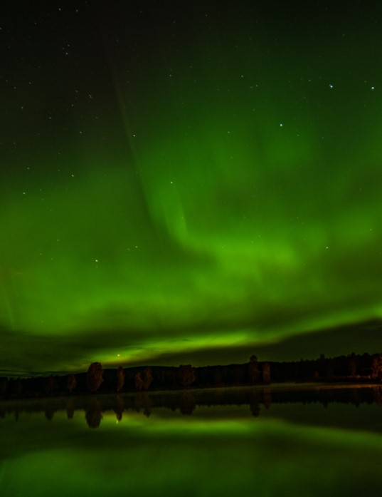
Dalarna University is close
The student experience
Create close relationships with teachers who will be your mentors.
Make close friendships with peers from around the world. Over 500 international students from 70 countries study at DU.
Always close to outdoor adventures
Photographer: Eva Grosso (former student)

Slide 16
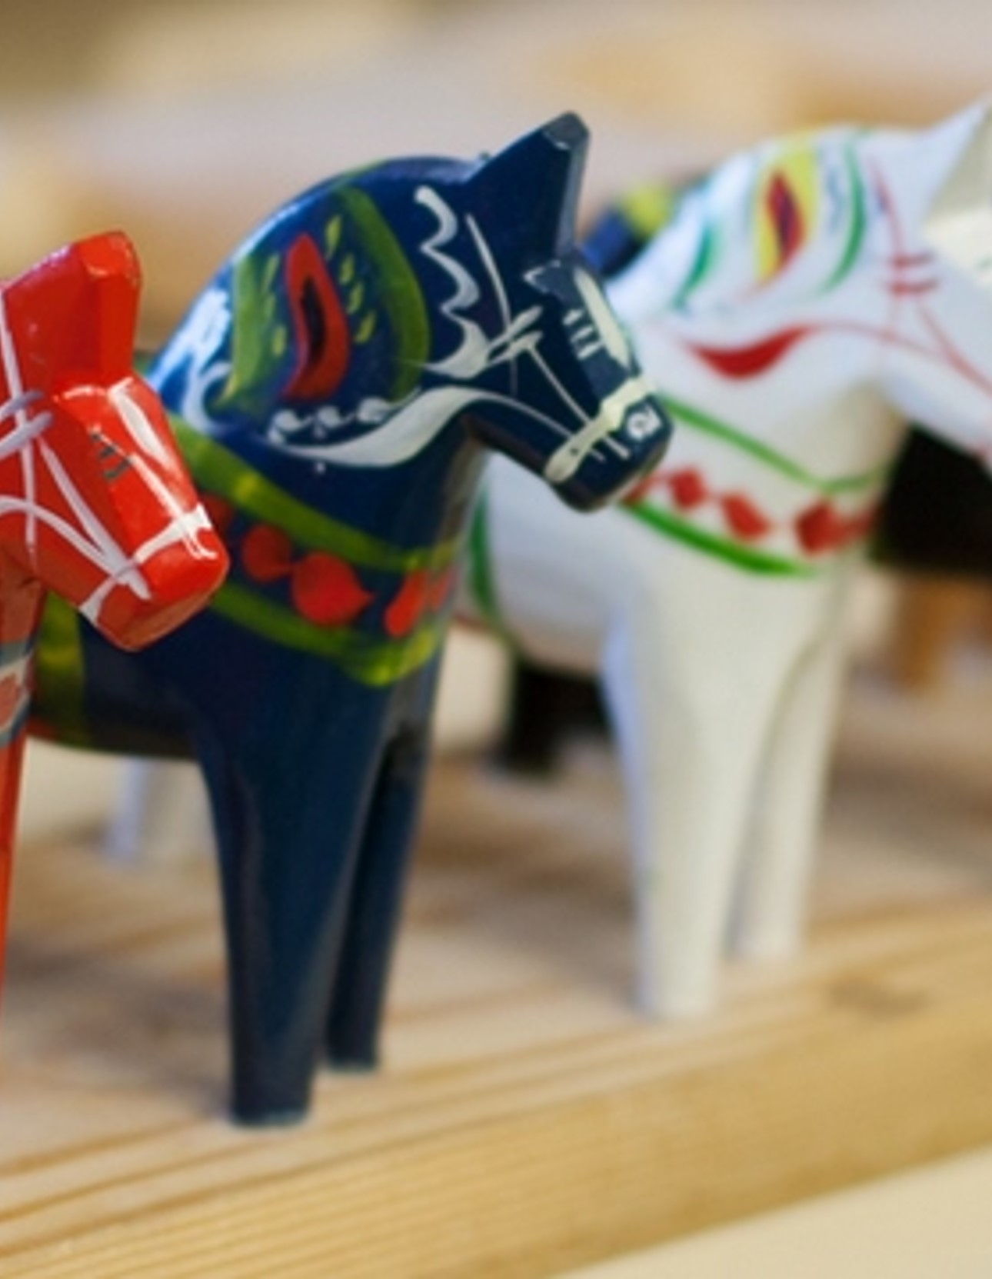
Dalarna University is close
The student experience
Create close relationships with teachers who will be your mentors
Make close friendships with peers from around the world
Always close to outdoor adventures
Close to Swedish cultural heritage
Photographer: Eva Grosso (former student)

Slide 17






Dalarna University is close
Working after studies
Create close relationships with teachers who will be your mentors.
Make close friendships with peers from around the world. Over 500 international students from 70 countries study at DU.
Always close to outdoor adventures
Close to innovative international employers

Slide 18
Master’s Programme in xxxxx
2-4 slides about your programme. Be sure to add relevant pictures
Include Unique Selling Points (USP) for your programme
Mention which external organizations the programme has partnerships with
Talk about job prospects for graduates of the programme
Option to include testimonial/reference from current student/alumni. If possible from same university/country you are visiting.
Notes:
We can help with content review

Slide 19
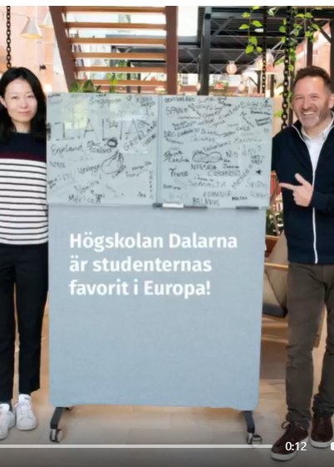
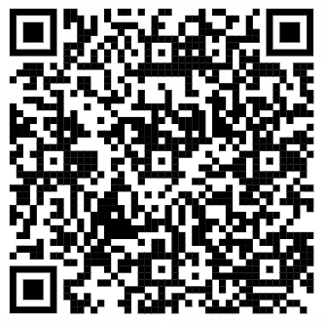

Thank you for watching!
Please contact us if you have any questions
xxxxxxx, Dalarna University
study@du.se
WhatsApp: +46737048079
Prefer to talk with students?
Instagram: @studyindalarna
Master’s Programme in xxxxxxxx
www.du.se/xxxxxxx
Photographer: Madelene Hall

